Slide 1
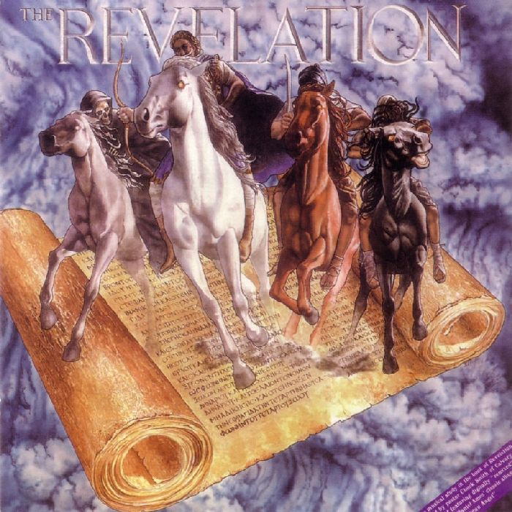
GOD’S REDEMPTIVE PLAN
FOR THE AGES
Lesson 8
Daniel
Precursory Studies to the Book of Revelation

Slide 2
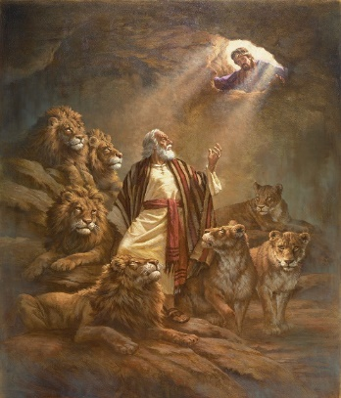
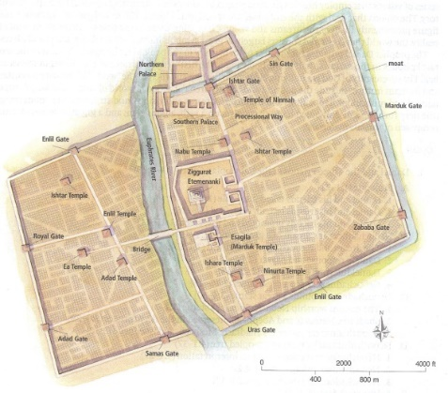
DANIEL (605-536)
While Ezekiel was taken to Babylon in 597
BC, Daniel was already there
He was deported with Hananiah, Mishael
& Azariah, among others in 605 BC
Daniel would minister into the 3rd year of the reign of Cyrus, king of Persia (Elam) (536 BC—10:1)
Daniel’s prophecies assert YHVH’s sovereignty over history and the kingdoms of the world
All the kingdoms of the world opposing YHVH will come to an end, and be replaced by the kingdom of God which will never pass away (2:44; 7:27)

Slide 3
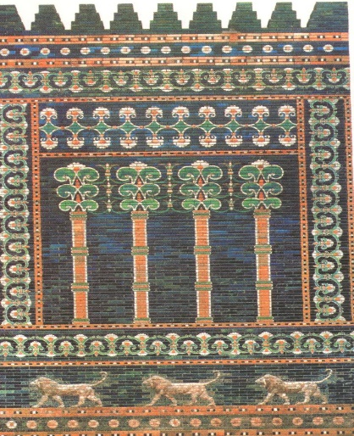
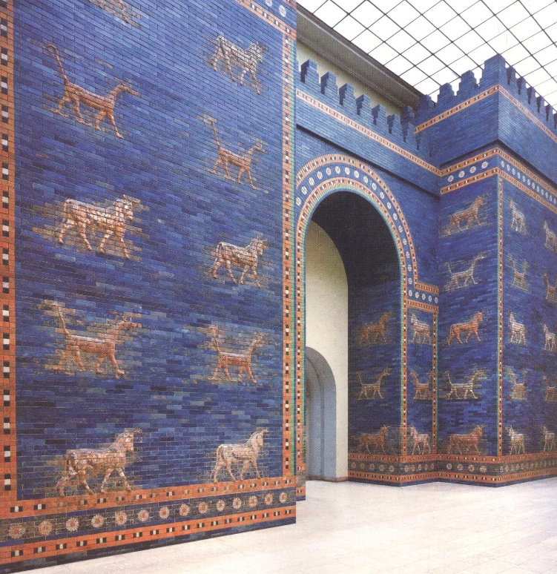
SERVICE IN THE KINGS COURT
Trained for service in the
kings court
Youths with no defect, good looking, showing intelligence in all wisdom, endowed with understanding, understanding and discerning knowledge
God gave them knowledge and intelligence in all writing and wisdom
Daniel even understood all visions and dreams (1:17)

Slide 4
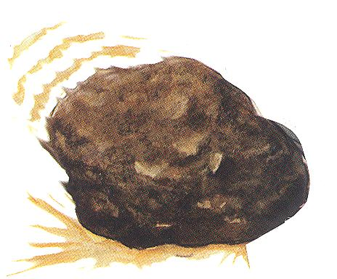
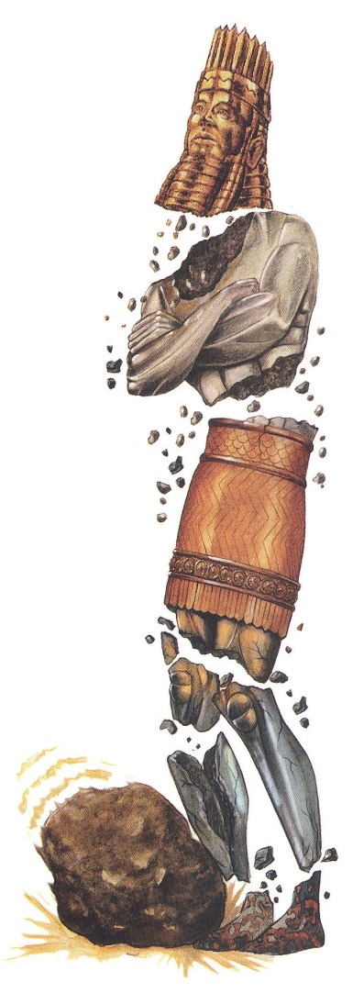
NEBUCHADNEZZAR’S DREAM (The end of days, latter days (2:31-35)
31 “You, O king, were looking and behold, there was a single great statue; that statue, which was large and of extraordinary splendor, was standing in front of you, and its appearance was awesome.
32 “The head of that statue was made of fine gold, its breast and its arms of silver, its belly and its thighs of bronze,
33 its legs of iron, its feet partly of iron and partly of clay.
34 “You continued looking until a stone was cut out without hands, and it struck the statue on its feet of iron and clay and crushed them.
35 “Then the iron, the clay, the bronze, the silver and the gold were crushed all at the same time and became like chaff from the summer threshing floors; and the wind carried them away so that not a trace of them was found. But the stone that struck the statue became a great mountain and filled the whole earth.
GOLD
SILVER
BRONZE
IRON
IRON &
CLAY

Slide 5
THE INTERPRETATION
The Times of the Gentiles
37 “You, O king, are the king of
kings, to whom the God of heaven has
given the kingdom, the power, the
strength and the glory;
38 and wherever the sons of men dwell, or the beasts of the field, or the birds of the sky, He has given them into your hand and has caused you to rule over them all. You are the head of gold.
39 “After you there will arise another kingdom inferior to you, then another third kingdom of bronze, which will rule over all the earth.
40 “Then there will be a fourth kingdom as strong as iron; inasmuch as iron crushes and shatters all things, so, like iron that breaks in pieces, it will crush and break all these in pieces.
41 “In that you saw the feet and toes, partly of potter’s clay and partly of iron, it will be a divided kingdom; but it will have in it the toughness of iron, inasmuch as you saw the iron mixed with common clay.
42 “As the toes of the feet were partly of iron and partly of pottery, so some of the kingdom will be strong and part of it will be brittle.
43 “And in that you saw the iron mixed with common clay, they will combine with one another in the seed of men; but they will not adhere to one another, even as iron does not combine with pottery.
B 6
A 0
B 5
Y -
L 5
O 3
N 9
GOLD
SILVER
BRONZE
IRON
IRON &
CLAY

Slide 6
But the stone that struck the statue became a great mountain and filled the whole earth.
A GREAT MOUNTAIN
44 "And in the days of those kings the God of heaven will set up a kingdom which will never be destroyed, and that kingdom will not be left for another people; it will crush and put an end to all these kingdoms, but it will itself endure forever.
45 "Inasmuch as you saw that a stone was cut out of the mountain without hands and that it crushed the iron, the bronze, the clay, the silver, and the gold, the great God has made known to the king what will take place in the future; so the dream is true, and its interpretation is trustworthy."

Slide 7
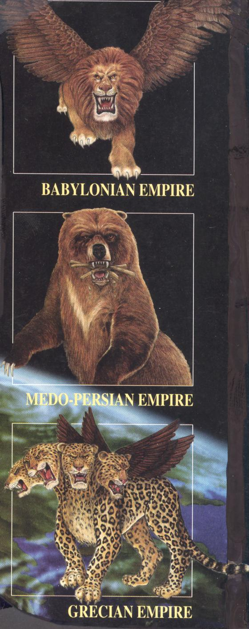
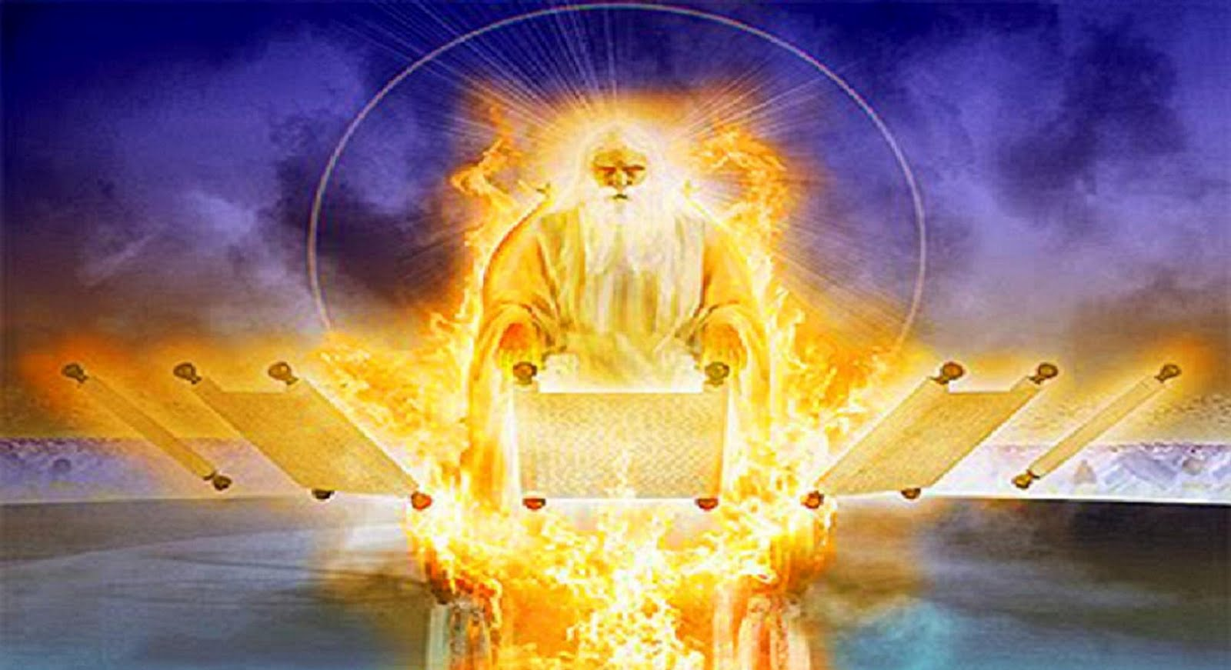
GOLD
SILVER
Daniel 7:2-10
God interprets the statue
BRONZE
IRON
IRON &
CLAY

Slide 8
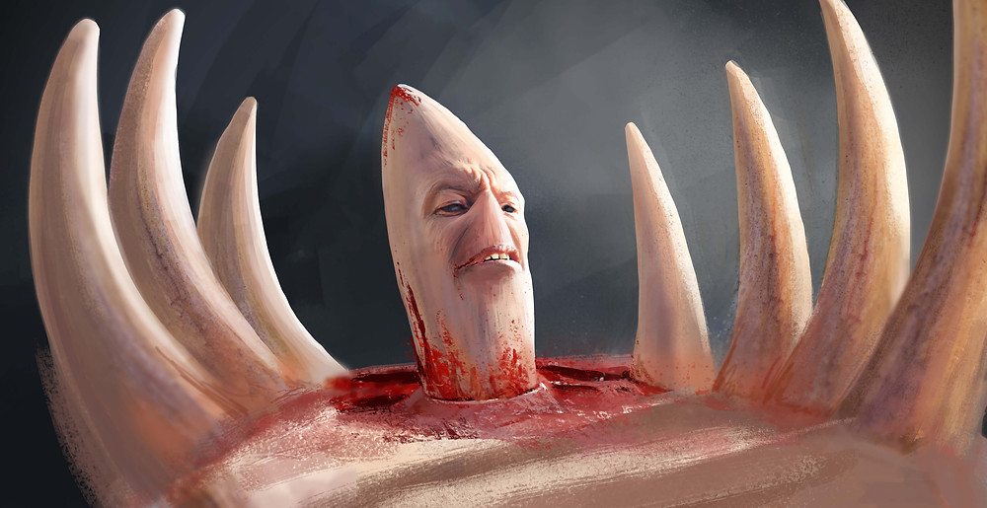
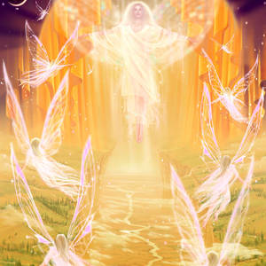
11 “Then I kept looking because of the sound of the boastful words which the horn was speaking; I kept looking until the beast was slain, and its body was destroyed and given to the burning fire.
12 “As for the rest of the beasts, their dominion was taken away, but an extension of life was granted to them for an appointed period of time.
13 “I kept looking in the night visions, and behold, with the clouds of heaven One like a Son of Man was coming, And He came up to the Ancient of Days And was presented before Him.
14 “And to Him was given dominion, Glory and that all the peoples, nations and men of every language might serve Him.
His dominion is an everlasting dominion
Which will not pass away;
and His kingdom is one
which will not be destroyed.

Slide 9
THE INTERPRETATION OF THE BEASTS (16-17)
17 ‘These great beasts, which are four in number, are four kings who will arise from the earth.
18 ‘But the saints of the Highest One will receive the kingdom and possess the kingdom forever, for all ages to come.’

Slide 10
THE FOURTH BEAST
19 “Then I desired to know the exact meaning of the fourth beast, which was different from all the others, exceedingly dreadful, with its teeth of iron and its claws of bronze, and which devoured, crushed and trampled down the remainder with its feet,
20 and the meaning of the ten horns that were on its head and the other horn which came up, and before which three of them fell, namely, that horn which had eyes and a mouth uttering great boasts and which was larger in appearance than its associates.
21 “I kept looking, and that horn was waging war with the saints and overpowering them
22 until the Ancient of Days came and judgment was passed in favor of the saints of the Highest One, and the time arrived when the saints took possession of the kingdom.
23 “Thus he said: ‘The fourth beast will be a fourth kingdom on the earth, which will be different from all the other kingdoms and will devour the whole earth and tread it down and crush it.
24 ‘As for the ten horns, out of this kingdom ten kings will arise; and another will arise after them, and he will be different from the previous ones and will subdue three kings.
25 ‘He will speak out against the Most High and wear down the saints of the Highest One, and he will intend to make alterations in times and in law; and they will be given into his hand for a time, times, and half a time.
26 ‘But the court will sit for judgment, and his dominion will be taken away, annihilated and destroyed forever.
27 ‘Then the sovereignty, the dominion and the greatness of all the kingdoms under the whole heaven will be given to the people of the saints of the Highest One; His kingdom will be an everlasting kingdom, and all the dominions will serve and obey Him.’

Slide 11
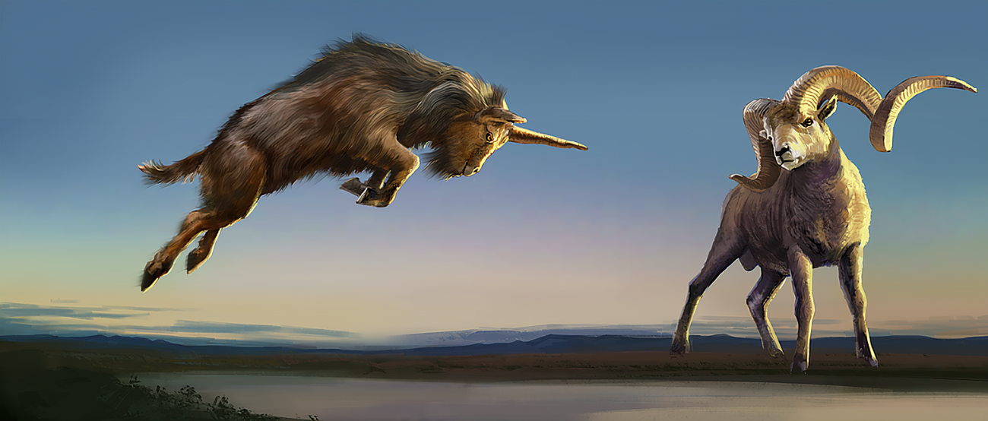
CHAPTER 8 The 2nd and 3rd Kingdoms
3 Then I lifted my eyes and looked, and behold, a ram which had two horns was standing in front of the canal. Now the two horns were long, but one was longer than the other, with the longer one coming up last.
4 I saw the ram butting westward, northward, and southward, and no other beasts could stand before him nor was there anyone to rescue from his power, but he did as he pleased and magnified himself.
5 While I was observing, behold, a male goat was coming from the west over the surface of the whole earth without touching the ground; and the goat had a conspicuous horn between his eyes.
6 He came up to the ram that had the two horns, which I had seen standing in front of the canal, and rushed at him in his mighty wrath.
7 I saw him come beside the ram, and he was enraged at him; and he struck the ram and shattered his two horns, and the ram had no strength to withstand him. So he hurled him to the ground and trampled on him, and there was none to rescue the ram from his power.

Slide 12
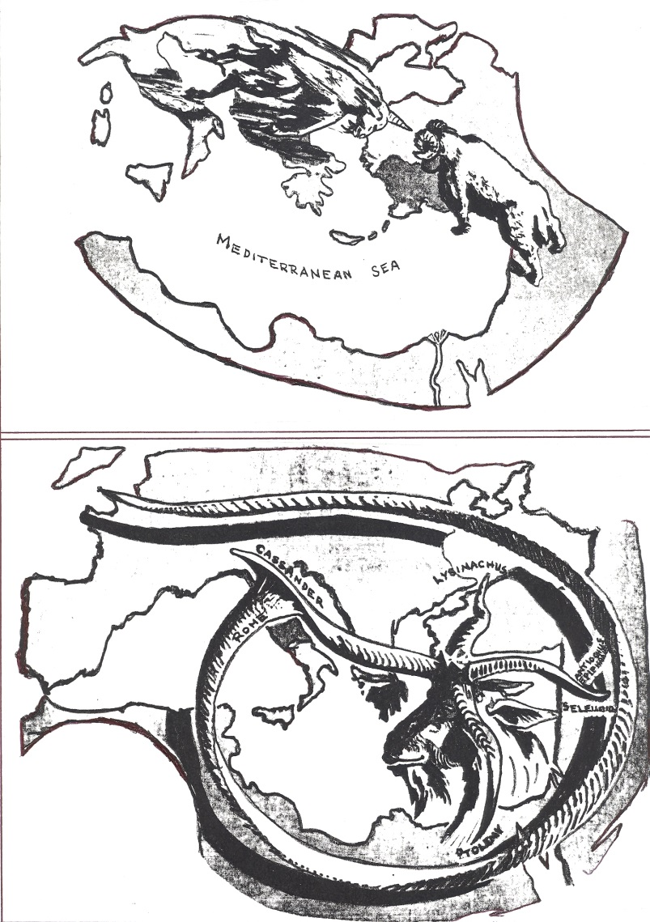
THE LITTLE HORN The Vision
8 Then the male goat magnified himself exceedingly. But as soon as he was mighty, the large horn was broken; and in its place there came up four conspicuous horns toward the four winds of heaven.
9 Out of one of them came forth a rather small horn which grew exceedingly great toward the south, toward the east, and toward the beautiful land.
10 It grew up to the host of heaven and caused some of the host and some of the stars to fall to the earth, and it trampled them down.
11 It even magnified itself to be equal with the Commander of the host; and it removed the regular sacrifice from Him, and the place of His sanctuary was thrown down.
12 And on account of transgression the host will be given over to the horn along with the regular sacrifice; and it will fling truth to the ground and perform its will and prosper.
13 Then I heard a holy one speaking, and another holy one said to that particular one who was speaking, “How long will the vision about the regular sacrifice apply, while the transgression causes horror, so as to allow both the holy place and the host to be trampled?”
14 He said to me, “For 2,300 evenings and mornings; then the holy place will be properly restored.”

Slide 13
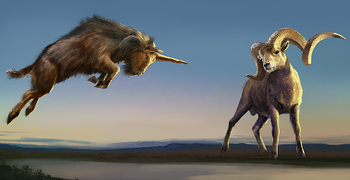
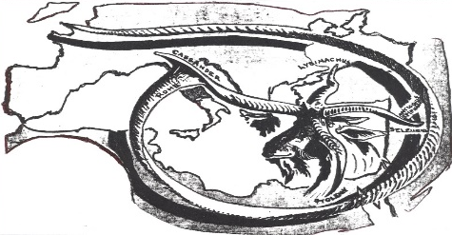
THE INTERPRETATION (8:17, 20-26)
17 So he came near to where I was standing, and when he came I was frightened and fell on my face; but he said to me, “Son of man, understand that the vision pertains to the time of the end.”
20 “The ram which you saw with the two horns represents the kings of Media and Persia.
21 “The shaggy goat represents the kingdom of Greece, and the large horn that is between his eyes is the first king.
22 “The broken horn and the four horns that arose in its place represent four kingdoms which will arise from his nation, although not with his power.
23 “In the latter period of their rule, When the transgressors have run their course, a king will arise, insolent and skilled in intrigue.
24 “His power will be mighty, but not by his own power,
And he will destroy to an extraordinary degree and prosper and perform his will;
He will destroy mighty men and the holy people.
25 “And through his shrewdness He will cause deceit to succeed by his influence; And he will magnify himself in his heart, And he will destroy many while they are at ease. He will even oppose the Prince of Princes
But he will be broken without human agency.
26 “The vision of the evenings and mornings Which has been told is true; but keep the vision secret, For it pertains to many days in the future.”

Slide 14
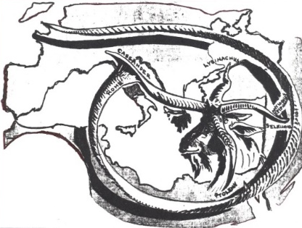
ALEXANDER THE GREAT
Seleucids
[Syria]
Antiochus IV
175-163 BC
WAR
Ptolemys
[Egypt]
Maccabean Revolt
164 BC

Slide 15
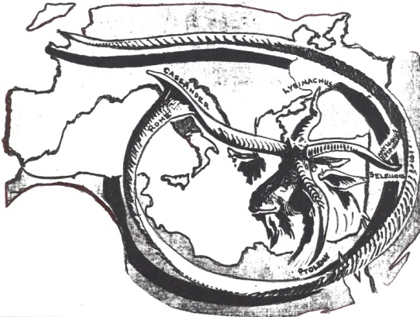
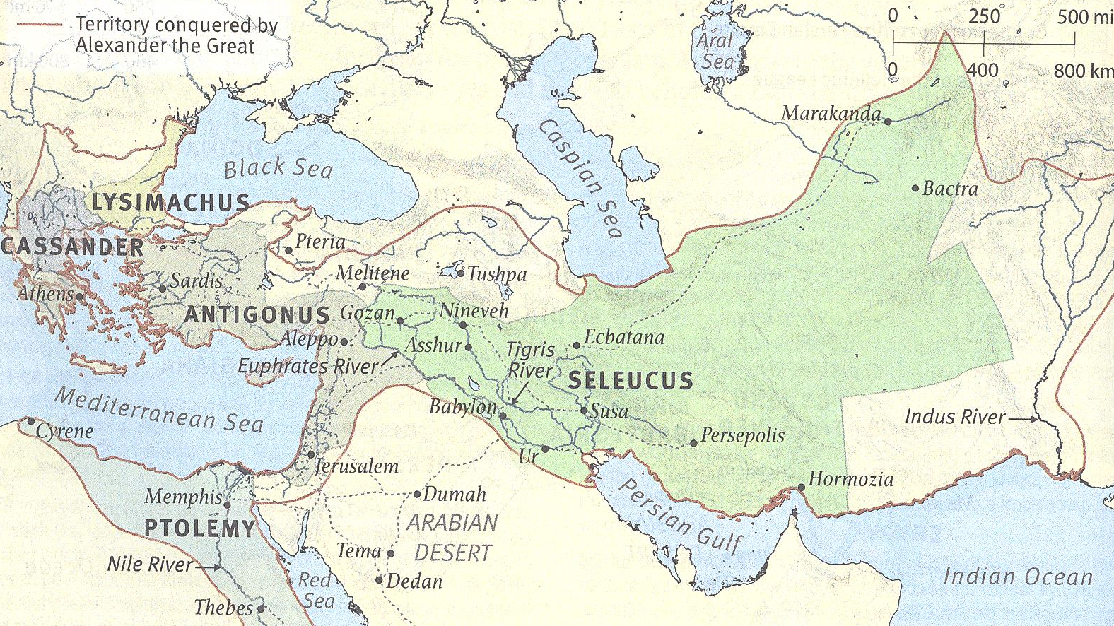
SELEUCUS & PTOLEMY

Slide 16
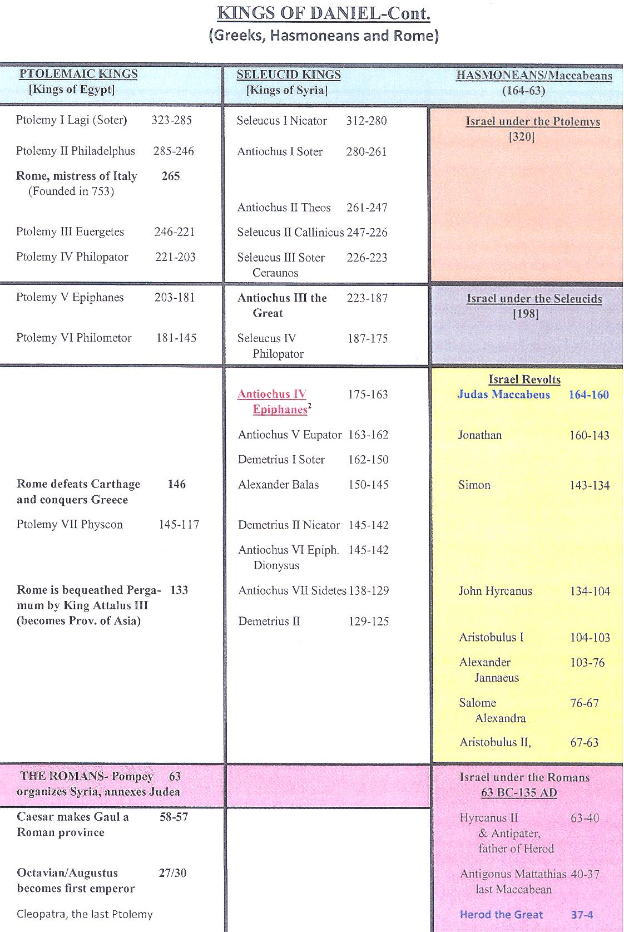
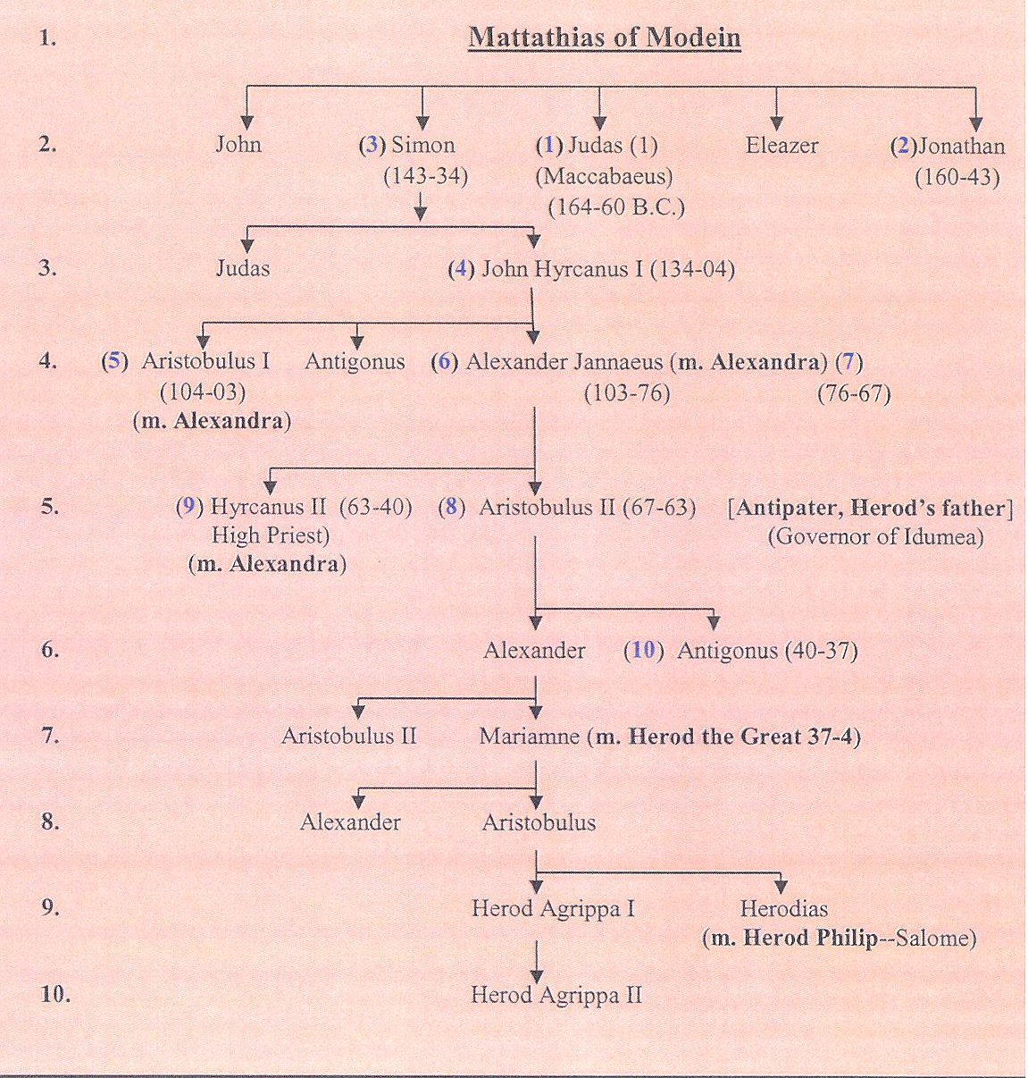
PTOLEMYS
SELEUCIDS
THE LITTLE HORN
&
MACCABEES

Slide 17
EARLY
LATE

Slide 18
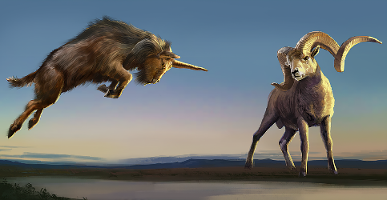
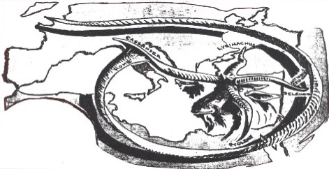
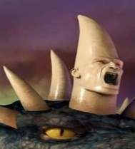
B 6
A 0
B 5
Y -
L 5
O 3
N 9
IN SUMMARY
Ch. 2, 7, 8
GOLD
M
E 5
D 3
O 9
P -
E
R 3
S 3
I 1
A
SILVER
G 3
R 3
E 1-
C -
I 6
A 3
BRONZE
IRON
6
R 3
O -
M 4
E 7
6
?
IRON &
CLAY

Slide 19
DANIEL 9 & JEREMIAH’S 70 WEEKS
Jer. 25:1-14—70 years
Dan. 9:24-27—seventy sevens (490 years)
24 “Seventy weeks have been decreed for your people and your holy city, to finish the transgression, to make an end of sin, to make atonement for iniquity, to bring in everlasting righteousness, to seal up vision and prophecy and to anoint the most holy place.
25 “So you are to know and discern that from the issuing of a decree to restore and rebuild Jerusalem until Messiah the Prince there will be seven weeks and sixty-two weeks; it will be built again, with plaza and moat, even in times of distress.
26 “Then after the sixty-two weeks the Messiah will be cut off and have nothing, and the people of the prince who is to come will destroy the city and the sanctuary. And its end will come with a flood; even to the end there will be war; desolations are determined.
27 “And he will make a firm covenant with the many for one week, but in the middle of the week he will put a stop to sacrifice and grain offering; and on the wing of abominations will come one who makes desolate, even until a complete destruction, one that is decreed, is poured out on the one who makes desolate.”

Slide 20
DANIEL 9 & JEREMIAH’S 70 WEEKS
Dan. 9:24-27—Jeremiah’s 70 years have 70 sets of
sevens (some say 490 years) added on to them
beginning with the return of the exiles or with the decree to restore and rebuild Jerusalem

Slide 21
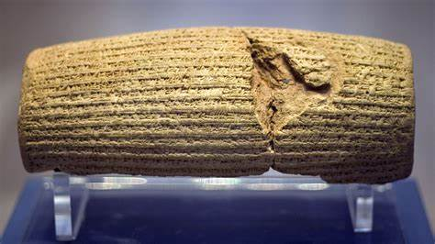
POSSIBLE BEGINNING DATES
538/39 BC—the decree of Cyrus (2 Chrn. 26:23; Ezra 1:2-4; but 538-490 = 48 BC—see picture above)
458 BC—the decree of Artaxerxes (Ezra 7:12-26; 458-490 = AD 33 remember, no year 0)
445 BC—the permission by Artaxerxes given to Nehemiah to rebuild the wall of Jerusalem and a house for himself (Neh. 2:5-8; cf. 2:1 for the date, 13 years after Ezra 7:7; but 445-490 = AD 46; some argue that the days of a year in Jewish time = 360 [12 x 30] giving a date somewhere around AD 32, 33)

Slide 22
70 WEEKS ARE DECREED
Daniel 9:25-27
Matthew 13
Parables
Prince who
is to come
From the Decree to Restore and Rebuild Jerusalem
538
458
445
7 Weeks
49 Years
62 Weeks
434 Years
Destruction
of the city
& sanctuary
by people of
Prince who is
to come 70 AD
To the end
Wars
Desolations
1 Week
7 Years
Strong
Covenant
Kingdom
Comes
Anointed
Cut-off
Nothing
?
3 ½
Years
3 ½
Years
Kingdom
Comes
Strong
Covenant
Wing of
Abominations
Decreed end
of Desolator
End of sacrifice
& offerings

Slide 23
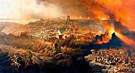
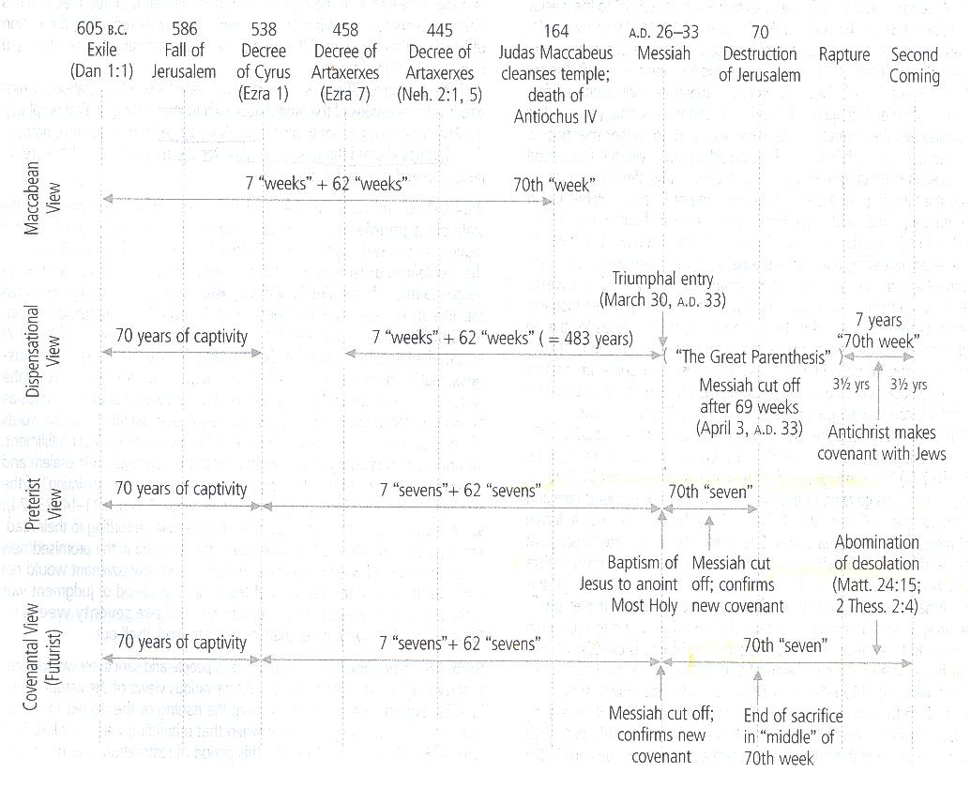
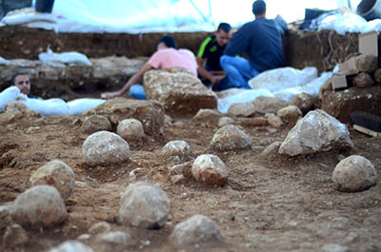
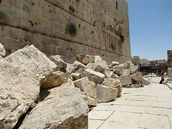
POSSIBLE SCENARIOS

Slide 24
DANIEL 11:36-45
36 “Then the king will do as he pleases, and he will exalt and magnify himself above every god and will speak monstrous things against the God of gods; and he will prosper until the indignation is finished, for that which is decreed will be done.
37 “He will show no regard for the gods of his fathers or for the desire of women, nor will he show regard for any other god; for he will magnify himself above them all.
38 “But instead he will honor a god of fortresses, a god whom his fathers did not know; he will honor him with gold, silver, costly stones and treasures.
39 “He will take action against the strongest of fortresses with the help of a foreign god; he will give great honor to those who acknowledge him and will cause them to rule over the many, and will parcel out land for a price.
40 “At the end time the king of the South will collide with him, and the king of the North will storm against him with chariots, with horsemen and with many ships; and he will enter countries, overflow them and pass through.
41 “He will also enter the beautiful land, and many countries will fall; but these will be rescued out of his hand: Edom, Moab and the foremost of the sons of Ammon.
42 “Then he will stretch out his hand against other countries, and the land of Egypt will not escape.
43 “But he will gain control over the hidden treasures of gold and silver and over all the precious things of Egypt; and Libyans and Ethiopians will follow at his heels.
44 “But rumors from the East and from the North will disturb him, and he will go forth with great wrath to destroy and annihilate many.
45 “He will pitch the tents of his royal pavilion between the seas and the beautiful Holy Mountain; yet he will come to his end, and no one will help him.

Slide 25
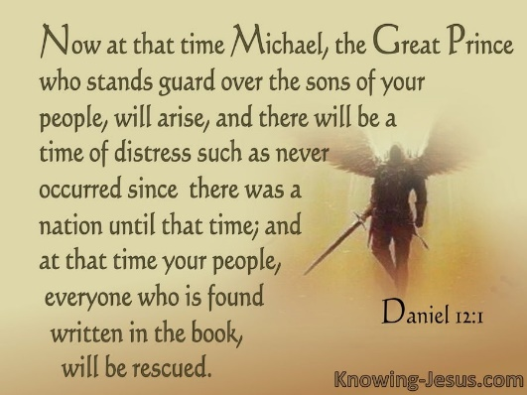
DANIEL 12:1-4
1 “Now at that time Michael, the great prince who stands guard over the sons of your people, will arise. And there will be a time of distress such as never occurred since there was a nation until that time; and at that time your people, everyone who is found written in the book, will be rescued.
2 “Many of those who sleep in the dust of the ground will awake, these to everlasting life, but the others to disgrace and everlasting contempt.
3 “Those who have insight will shine brightly like the brightness of the expanse of heaven, and those who lead the many to righteousness, like the stars forever and ever.
4 “But as for you, Daniel, conceal these words and seal up the book until the end of time; many will go back and forth, and knowledge will increase.”

Slide 26
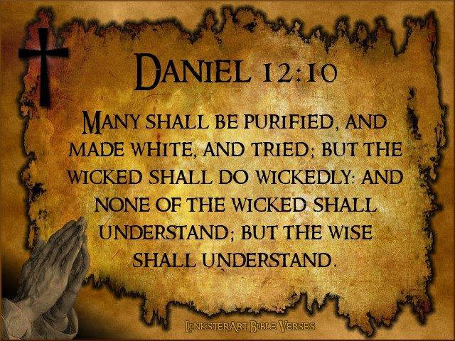
DANIEL 12:5-13
5 Then I, Daniel, looked and behold, two others were standing, one on this bank of the river and the other on that bank of the river.
6 And one said to the man dressed in linen, who was above the waters of the river, “How long will it be until the end of these wonders?”
7 I heard the man dressed in linen, who was above the waters of the river, as he raised his right hand and his left toward heaven, and swore by Him who lives forever that it would be for a time, times, and half a time; and as soon as they finish shattering the power of the holy people, all these events will be completed.
8 As for me, I heard but could not understand; so I said, “My lord, what will be the outcome of these events?”
9 He said, “Go your way, Daniel, for these words are concealed and sealed up until the end time.
10 “Many will be purged, purified and refined, but the wicked will act wickedly; and none of the wicked will understand, but those who have insight will understand.
11 “From the time that the regular sacrifice is abolished and the abomination of desolation is set up, there will be 1,290 days.
12 “How blessed is he who keeps waiting and attains to the 1,335 days!
13 “But as for you, go your way to the end; then you will enter into rest and rise again for your allotted portion at the end of the age.”

